Slide 1
Polar Vortex Meeting (JWST-3 AR)
Fuda Nguyen, Daniel Apai, Mark Marley, Travis Barman, Nikku Madhusudhan, Xianyu Tan

Slide 2
Agenda
Main:
Motivation, proposal goals.
Insights from past meetings.
Current progress.
Current implementation plan.
Discussion.
Summary, action items.

Slide 3
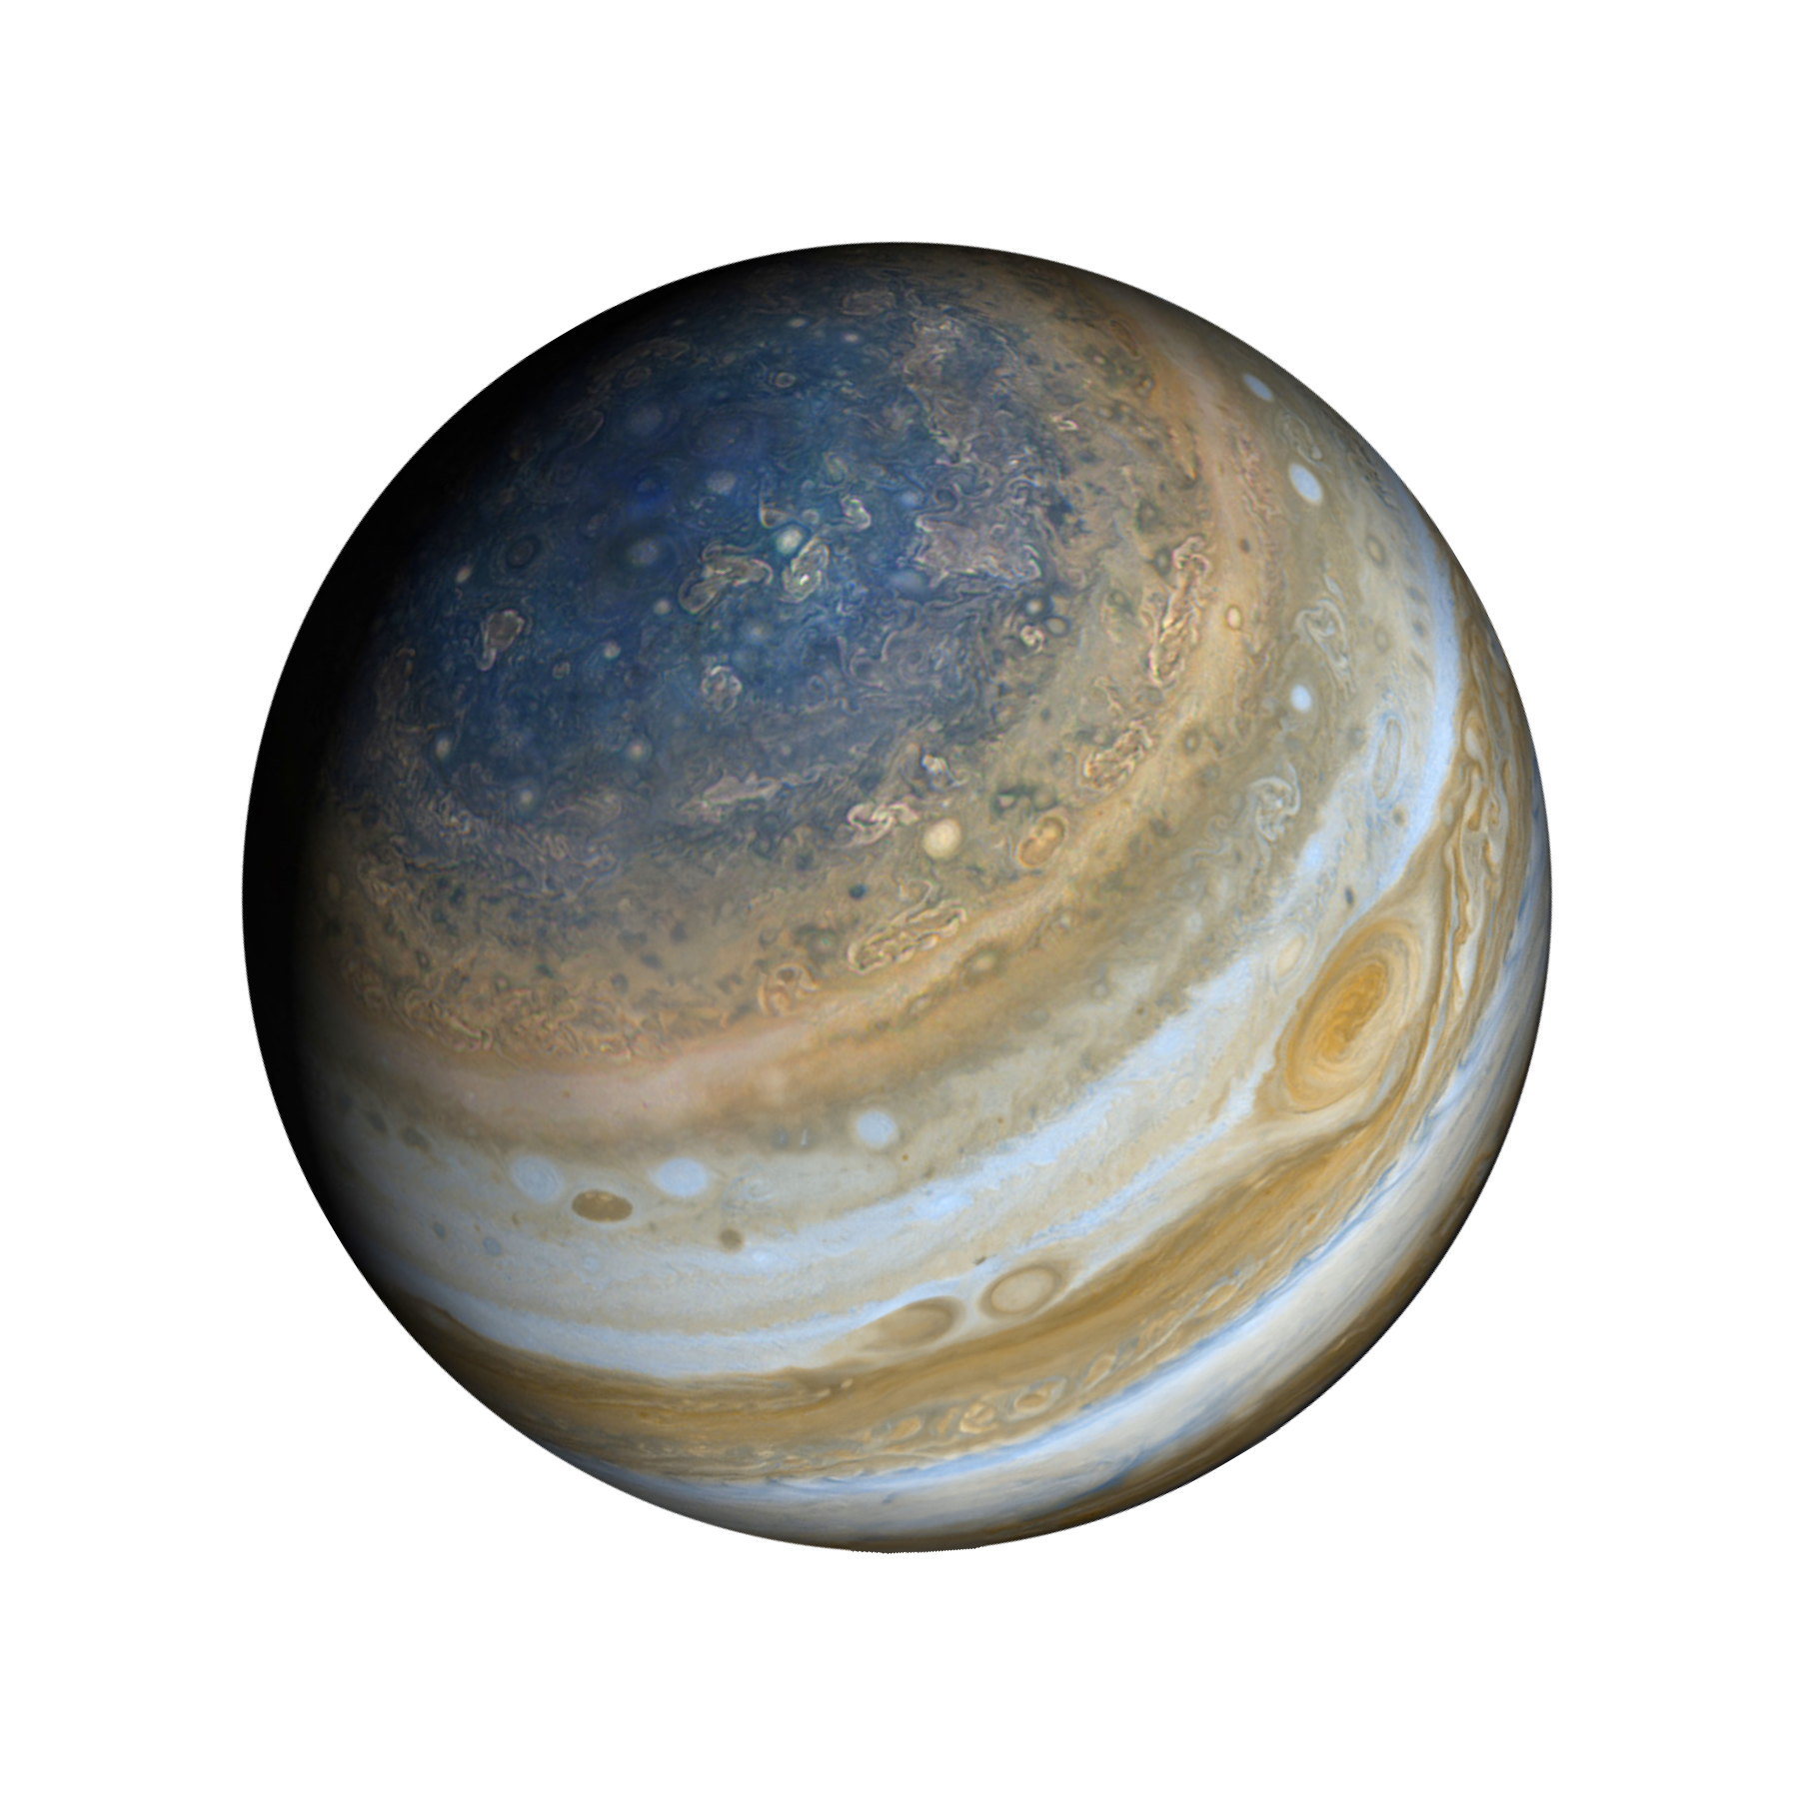
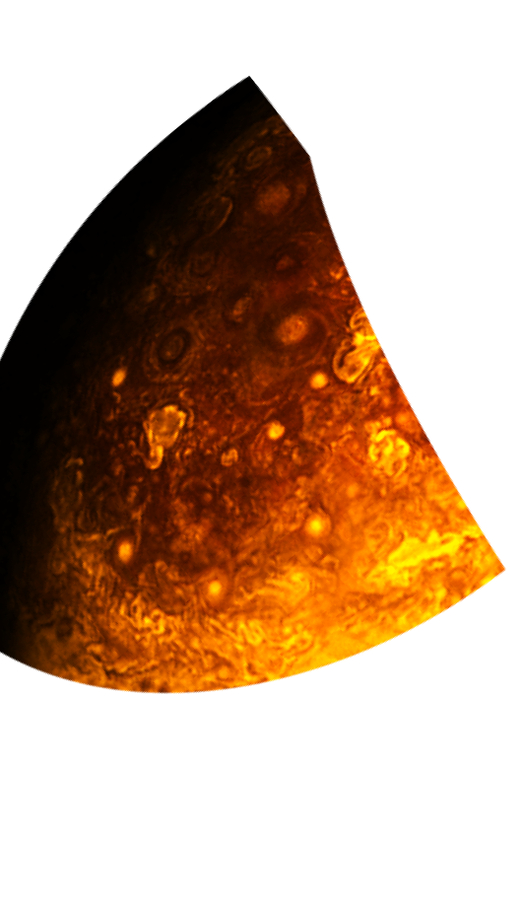

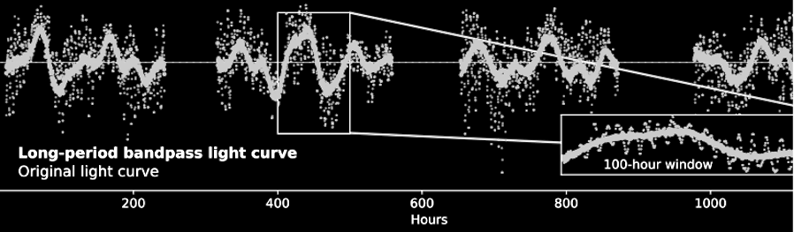
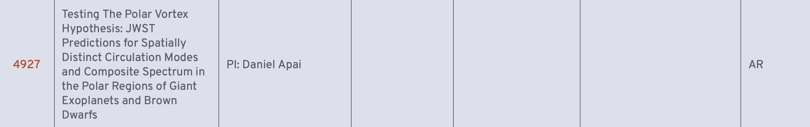
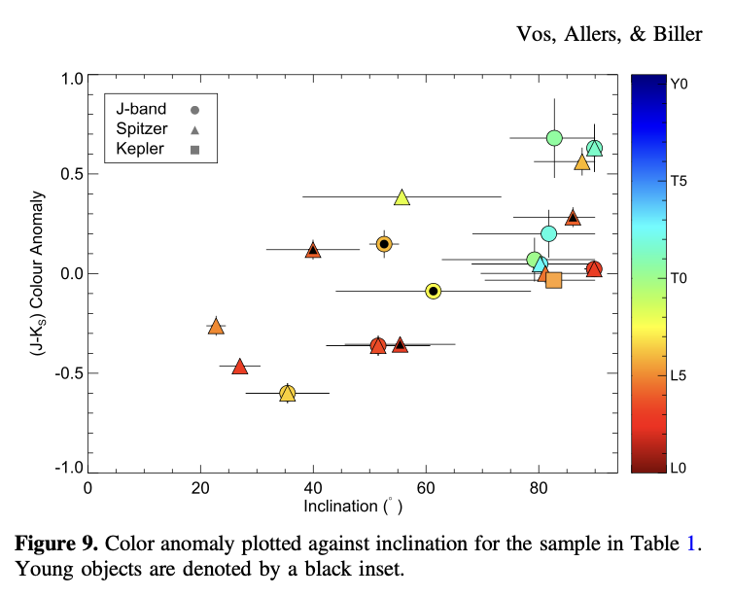

Motivation, goals
Motivation:
Unexplained trends from ultracool atm. data:
Long-period light curves (i.e. Fuda et al 2024, V1 model)
Color-inclination trends: pole-on BDs redder than equator-on BDs, less cloudy.
Objects like Jupiter showcasing pole-to-equator evolution in cloud, color, circulation
The same objects look different at inclination due to 3D complexities
Cycle 3 proposal (PI: Daniel): written for model framework and archival data
Cycle 4 proposal (PI: Fuda): awarded long-baseline observation for 3 BDs of different viewing angle to test the Polar Vortex hypothesis.
Goals:
Model capability:
Multicomponent 3D model, combining GCMs prediction and multi-1d atmospheres spectral component.
Multipressure: 30 pressure layers, completed with custom cloud configuration
Target object: L-T transition brown dwarfs in {T,log(g)} range.
Publications:
V2 Model paper: detailing Polar Vortex v2 forward modeling framework
AR data component: could be its own paper or combined with other paper.
Implication:
Model could be applied to JWST#4 program
Vortex- dominated ?
Thinner cloud-decks ?
Slowly varying polar regions ?
Jet-dominated ?
Thicker cloud decks ? Short-period rotationally modulating bands and belts ?
1. Luhman 16 AB, TESS lightcurve, 1200 hours monitoring (Fuda+ 2024, Apai+ 2021): Complex short & long-term modulation
Polar Vortex Hypothesis
2. L-T BDs silicate-inclination relationship: Poles less cloudy than equator
(More: Vos et al. 2020, 2017)

Slide 4
Past meetings review
Many discussion items. Some important notes to implementation:
PICASO are useful: 1d calculation, contribution function, pressure-dependent spectra, cloud configs creation (however, 3d ability is mostly latitudinally-blind – disco ball implementation).
GCMs parameterization: will be key spatial features manifestation and their evolution timescale/behavior.
Current progress
PICASO routine, creation of simple cloud model and pressure-dependent setup (could also try and generate cloudy/cloudfree CF from Madhu and Travis’s 1D model)
Rewriting spatiotemporal setup to
1) optimize for rapid reproduction
2) incorporate gcms-input later (i.e. a global map of circulation cells)

Slide 5
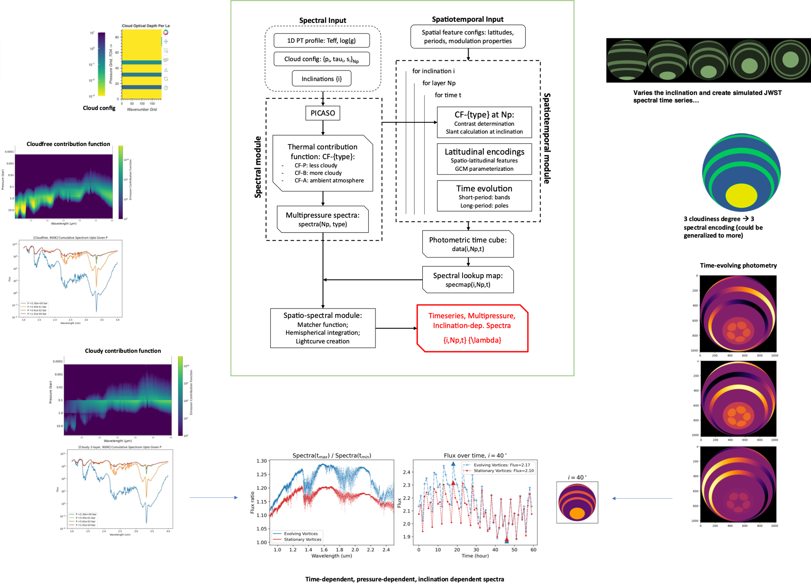
Current implementation plan
GCM parameterized spatial features goes in here

Slide 6
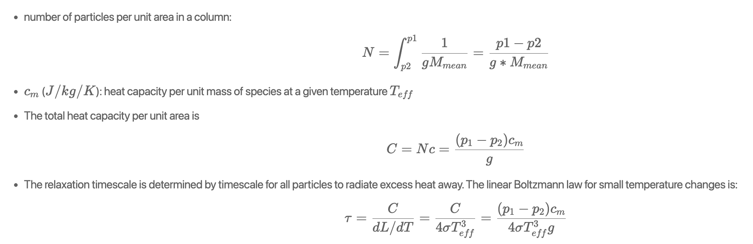
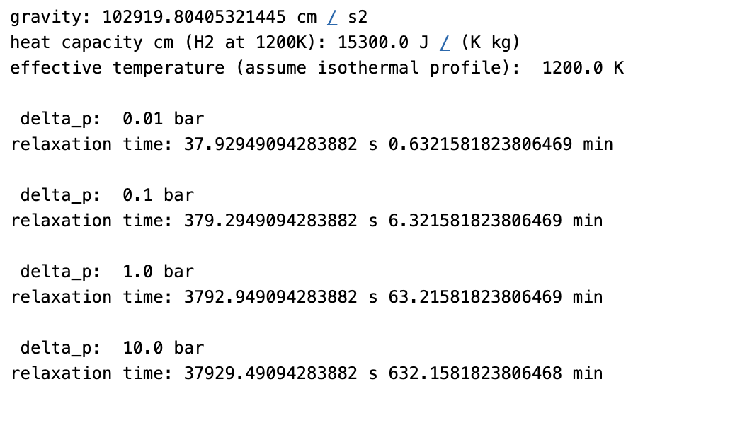
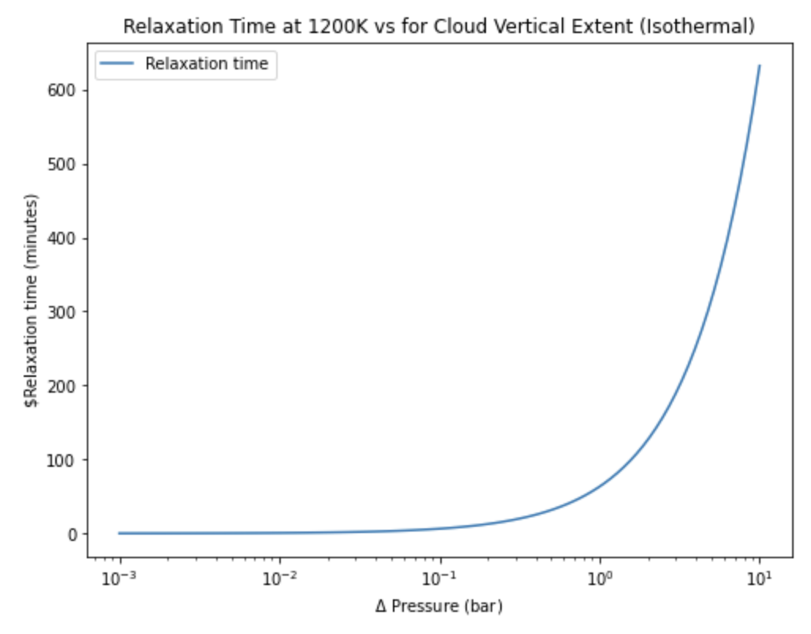
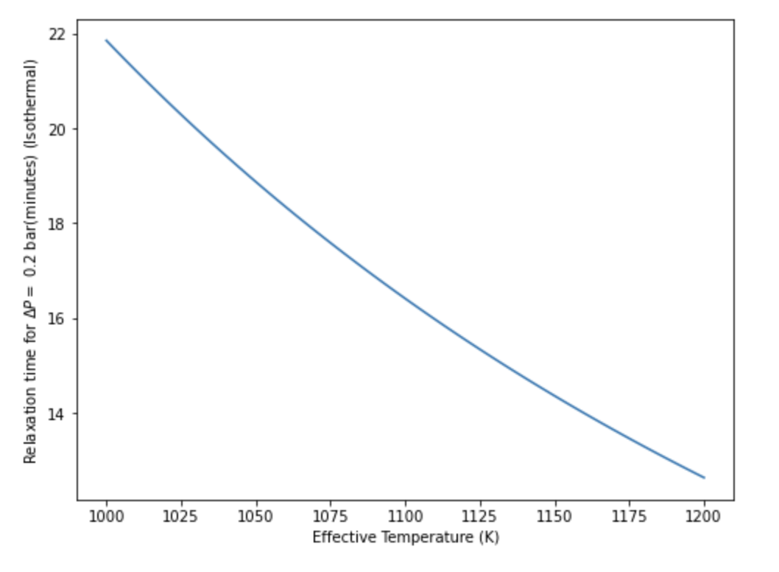
Cloud thermal relaxation

Slide 7
Discussion
abundance vs cloud: abundance variation at longer wavelengths
make sure the model is energy-consistent (balanced with observation precision)
preparing for evolution of object with time – energy conservation
spatial averages in JWST age and precision
short period can give some clues on cloud vs composition
note on project overall goals: brainstorm on hypothesis testing you can do with just the model (also applicable to DI planets, SS observations) → keep check of complexity
Share overleaf documents (fuda is prepping)
Not object-specific, rather population trends. Iterate on reasonable T/log(g) grid.

Slide 8
Summary, action items

